Slide 1
PRE-COVID (2019) SOFIA REAL ESTATE MARKET CONDITIONS ANALYSIS
Riste Petrov

Slide 2
The underlying task at hand
What was the requirment for the homework/research at hand?
- Real data challenge: specify and estimate a model for price prediction of apartments in Sofia
- Assignment output: a brief research report (ppt presentation) with your major findings.

Slide 3
STAGES OF THE ANALISYS
DATA OBSERVATION
By observing the available dataset, I will set possible hypotheses.
DATA MANAGEMENT
Setting the data into the desired formats to achieve the most effective analysis.
REGRESSION MODELS
To test the hypothesis about the real estate market.
INTREPETING THE RESULTS
RESULTS BASED INSIGHTS
Interpretation of the results and testing of the hypothesis.
Using insights to help stakeholders make better decisions

Slide 4
Data Analysis
From the available dataset, there were 14 variables available; 12 were used (some with data management, some without). Fewer of the baseline ones were used to test the hypothesis and conduct the regression models.
Variables: (Name – operation – desctiption) * - modifed, X – excluded, T – transformation , D – dummy, N – none
Type – *, D - type of property
Regiid – X – region of the property
Townid – X – town of the property
Quartid - *, T – the neighborhood of the property
Price (Euro) – T (ln) – the advertised price for the property
Euro/sq.m. – t (ln) – the price per sq. meter
Area – T (mean,med per neig.) – area/size of the property
Constr. - *, D - type of construction of the property
Year – t (mean med per neig.) – construction year
Floor – N – floor of the property
TEC - * - central heating variable (ДА/НЕ) – transformed to 1/0
Published or Renewed & Valid date – * – a made a operational variable from both of them named Listing days.
Seller – D – Either Agency or Individual (personal_seller)
P.S If there was data if the appartment had furniture and was remonted would have made the whole research more precise.

Slide 5
Data Management
The following changes were made
Type – was modifed to have 5 categories
instead of 7 unique categories. With 2 extra dummies
Quartid – evolved into 4 different variables
NS cordinate
WE cordinate
Distance from center
Metro
Price (Euro) & Euro/sq.m. – were transformed into natural logs for regression purposes.
Area & Year – had Mean & Median calculated per neighborhood (to assess premiums.)
Constr. – construction variable was split into three dummies for each category (Panel, NPK, Brick).
Heating – was modifed to be a logical instead of char. type.
Personal Seller - dummy was used to see does agencies affect price

Slide 6
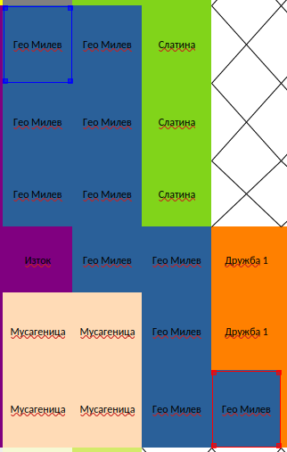
Quartid dummies - calculation
A prop map of Sofia’s neighborhoods was done in Excel.
Each square is 500m x 500m
Using the map, each neighborhood’s central point was calculated and set to be the NS = [-9,9] and WE = [-9,9] cordinate.
Using the Pythagorean theorem, the aerial distance from the center was calculated.
Distance from Center = √(NS² + WE²)
When compiling the map each neighborhood was asigned if it had metro access or not.
NS formula for Geo Milev
=-(ROUND((ROW($MAP.AA25)
+ ROW($MAP.AD30)) / 2, 1) - 21) / 2
WE formula for Geo Milev
=(ROUND((COLUMN($MAP.AA25) +
COLUMN($MAP.AD30)) / 2, 1) - 19) / 2

Slide 7
Regression Analysis
DIAGNOSTIC model
Using ln(euro_sq_meter)
to determine the right regressors.
BIG DATA model
Predicting ln(price) using all economically sound and econometrically appropriate regressors.
NO BIG DATA model
Predicting ln(price) using
layman-accessible regressors.

Slide 8
Diagnostic Model
Test Model
Sample restrictions
Neighborhood BIAS was present
Assesment of proper independed variables and testing the hypotesis that location, proximity to the center & access to public transport are the crutial factors influencing the price.
The sample was restricted with construction type brick and access to metro in order to diagnostisize the more crutial non dummie variables.
Half of the Neighborhoods had approximately 85% of all observations in the data.

Slide 9
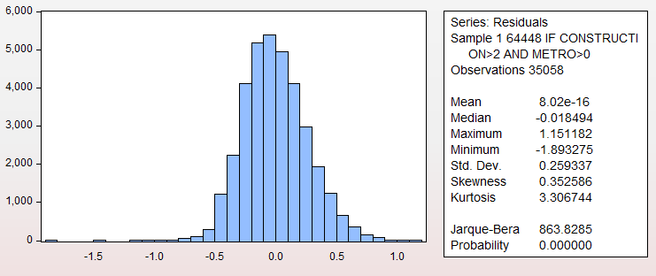
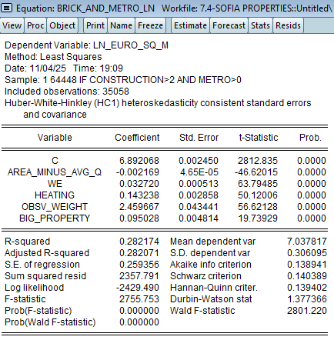
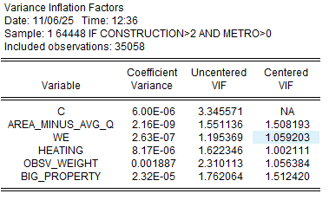
Diagnostic Model

Slide 10
Big Data Model
Main Model
Intended use by RE Agencies and Serious Brokers
Full Dummy utalization
Maximizing the prediction power and overall stability model of price setting by the regressors available.
Most RE Agencies have sample data about the postings in each area. There for the use of the Means and Medians of each neighbourhood was used, to caculate the diviations of the area and year of construction to set most efficient premiums.
Dummy utilization was essential for specifying various nuances in properties.

Slide 11
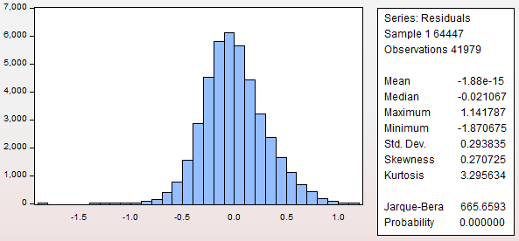
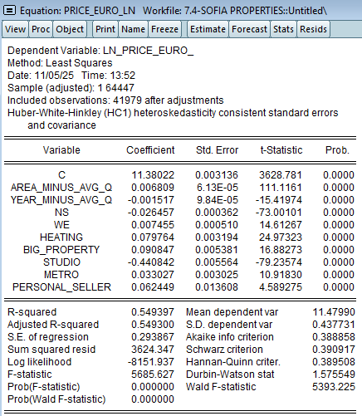
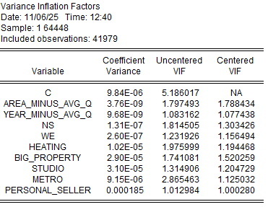
Big Data Model

Slide 12
NO Big Data Model
Practical Model
Simplifed version
Most crutial Dummy Variables
Layman guide for getting a guide for pricing properties.
Procentage change in price because of the simple regressors used.
Property access to central heating, metro station and dealing with personal sellers.

Slide 13
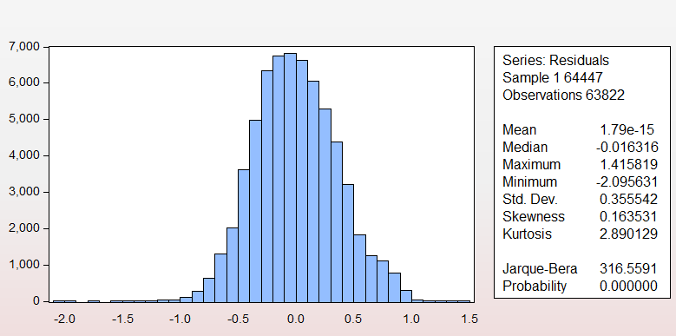
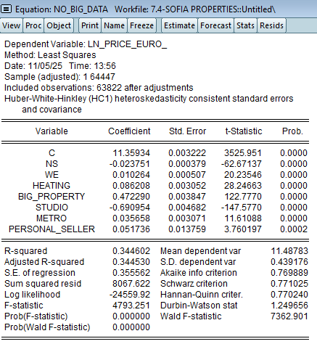
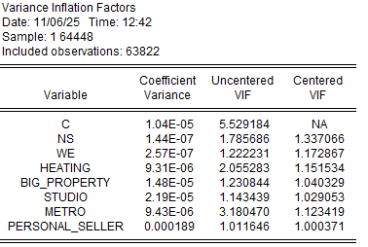
NO Big Data Model

Slide 14
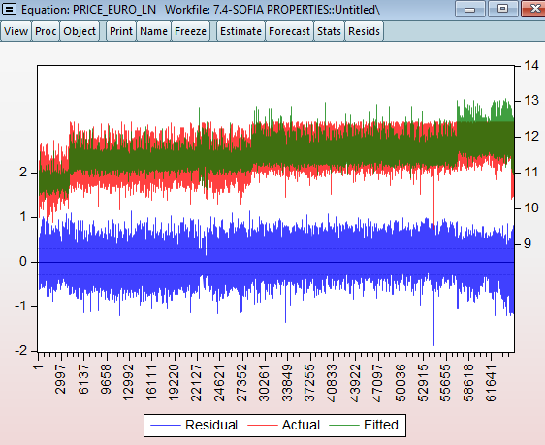
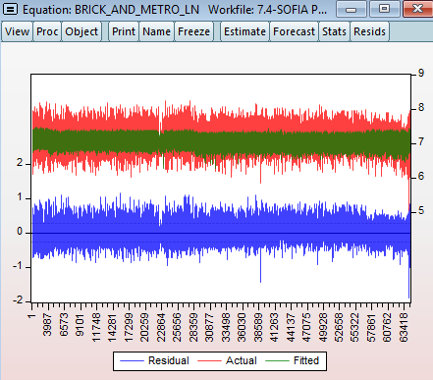
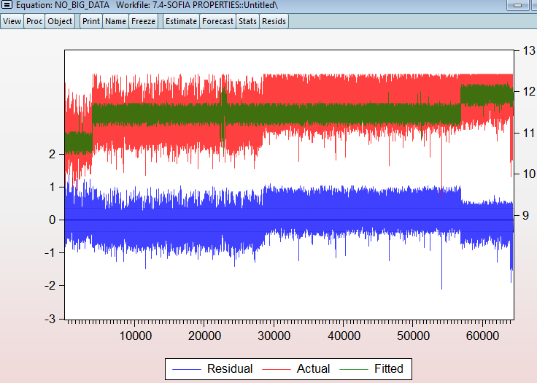
Residual Analysis

Slide 15
Quick Summary
Location
Location of the properties is influenced aproximetly by
-2% for every 1km - North off the Center
+1% for every 1km – East off the Center
Metro
Properties that have a Metro station nearby
results in an increase of price by around 3.5%.
Cental Heating & Personal Seller
Central Heating increases the price by around 8%
& Personal Seller increases the price by around 6%

Slide 16
— Baron Harold Samuel , founder of Land Securities (UK)
Thank you for your attention
Q&A
“Real estate is all about location, location, location.”

